Slide 1
COSMOS Intermediate
Made by Taufeeq Rahmani
Course Content
28th April 2016

Slide 2
Agenda.
Made by Taufeeq Rahmani
Parameters and Preprocessors in SCOPE
Combining Rowsets with SET Operators
Combining Rowsets with JOIN Operators
Extending SCOPE with C#
  Structured Streams
  StreamSets
  Extractor
  Processor
  Reducer
  Outputter
  Aggregates
Important C# snippets

Slide 3
SCOPE has several things that share the name of Parameters
Internal parameters – the values of these parameters are established through the #DECLARE preprocessor keyword. When used in a script, a preprocessor parameter will look like this: @foo. A single @ sign prefix identifies "foo" as a preprocessor parameter. For legacy reasons you may occasionally hear these referred to as "New-Style Parameters."
External parameters – the values of these parameters are not in the Scope script – instead the values are provided by the user when the Script is run. When used in a script, a script submission parameter will look like this: @@foo@@ - a pair of @@ symbols surround "foo" and identify it as a Script Parameter. For legacy reasons, you may occasionally hear these referred to as "Old-Style Parameters.”
Parameters in Views/Functions/Procedures – These are parameters passed to Views, Functions, or Procedures by Scope code. Like preprocessor parameters, when you see them in the body of the View, Function, or Procedure they will appear like this: @foo.

Slide 4
Internal and External Parameters
Internal Parameters:
The #DECLARE instruction to create typed parameters
Examples:
  #DECLARE a string = "Hello World";
  #DECLARE ds1 string = "2010/03/31";
DECLARE cannot call methods on types (like MyHelper) that are user-defined. Values cannot be assigned from a RowSet
External Parameters:
External Parameters are used to keep the script same while modifying the values being used.
The actual values for script parameters do not exist in the Scope script – instead when the Script is run the user must provide them

Slide 5
The preprocessor is a special limited language that is fully interpreted by Scope before the script is compiled
All statements starting with # are preprocessor statements
the Scope preprocessor allows you do to several things:
  Define values that can be reused in your script – these are the preprocessor parameters we mentioned earlier that are created via the #DECLARE keyword.
  Switch between alternating sections of code depending on some condition using the #IF and #ELSE keywords

Slide 6
Agenda.
Made by Taufeeq Rahmani
Parameters and Preprocessors in SCOPE
Combining Rowsets with SET Operators
Combining Rowsets with JOIN Operators
Extending SCOPE with C#
  Structured Streams
  StreamSets
  Extractor
  Processor
  Reducer
  Outputter
  Aggregates
Important C# snippets

Slide 7
Two Rowsets can be combined using the UNION operator
UNION DISTINCT
union_distinct = SELECT * FROM a
UNION DISTINCT
SELECT * FROM b;
UNION ALL
union_all = SELECT * FROM a
UNION ALL
SELECT * FROM b;
id:int | Name
1 | Smith
2 | Brown
3 | Case
4 | Dey
id:int | Name
1 | Smith
1 | Smith
2 | Brown
3 | Case
1 | Smith
1 | Smith
1 | Smith
2 | Brown
4 | Dey
4 | Dey

Slide 8
Intersect operator gives only those rows which are common in both rowsets
INTERSECT DISTINCT
rs1 = SELECT * FROM a
INTERSECT DISTINCT
SELECT * FROM b;
INTERSECT ALL
rs2 = SELECT * FROM a
INTERSECT ALL
SELECT * FROM b;
id:int | name
1 | Smith
1 | Smith
2 | Brown
id:int | name
1 | Smith
2 | Brown

Slide 9
Agenda.
Made by Taufeeq Rahmani
Parameters and Preprocessors in SCOPE
Combining Rowsets with SET Operators
Combining Rowsets with JOIN Operators
Extending SCOPE with C#
  Structured Streams
  StreamSets
  Extractor
  Processor
  Reducer
  Outputter
  Aggregates
Important C# snippets

Slide 10
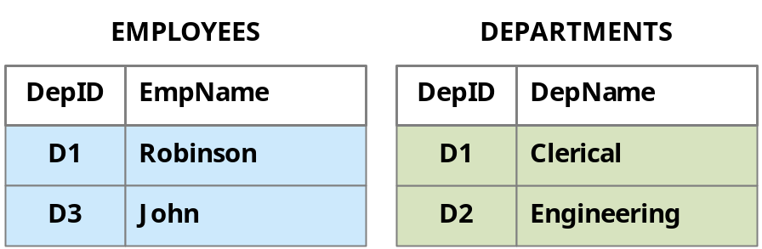
JOIN operators combine rowsets into a new rowset based on matching a field in one RowSet to a field in another RowSet
We will try t understand the concept of joins using an example. Let us consider the following rowsets:
An INNER JOIN of these two rowsets will return the combined rows where the DepID field matches.
A LEFT OUTER JOIN is a superset of the INNER JOIN that includes ALL the rows from the left rowset. Because D3 is not present in the right rowset, NULL values are used for that output row.
A RIGHT OUTER JOIN is a superset of the INNER JOIN that includes ALL the rows from the right rowset. Because D2 is not present in the right rowset, NULL values are used for that output row.
A FULL OUTER JOIN is a combination of the LEFT OUTER and RIGHT OUTER JOIN
Using OUTER JOIN without specifying LEFT, RIGHT, or FULL indicates a LEFT OUTER JOIN

Slide 11
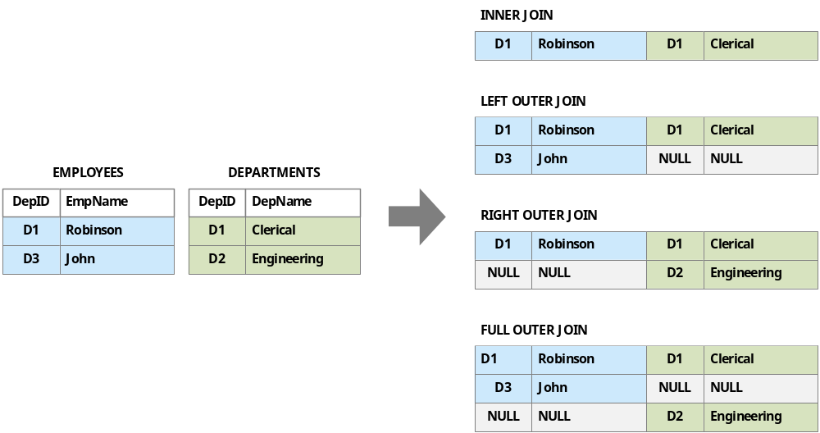
An illustration of the all the Joins

Slide 12
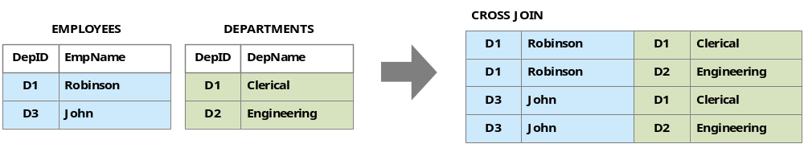
CROSS JOIN is basically an INNER JOIN without a join condition – it returns all the possible combinations of records
It is the Cartesian product of the records in both rowsets
SEMIJOIN
It is easiest to think of SEMIJOIN as a way to filter a rowset.
There are two variants: LEFT SEMIJOIN and RIGHT SEMIJOIN.
LEFT SEMIJOIN -> Give only those rows in the left rowset that have a matching row in the right rowset.
RIGHT SEMIJOIN -> Give only those rows in the right rowset that have a matching row in the left rowset

Slide 13
Important points to remember about Joins
If you leave out LEFT or RIGHT, and instead simply write SEMIJOIN then what you get is LEFT SEMIJOIN
SQL has an ANTIJOIN operator, but Scope does not
Don’t use Implicit INNER JOIN, instead make it explicit. This means that WHERE conditions or Aggregate functions should not be used
If you leave out INNER or OUTER, and instead simply write JOIN then what you get is INNER JOIN
If you leave out LEFT or RIGHT, and instead simply write OUTER JOIN then what you get is LEFT OUTER JOIN
CROSS JOIN should be avoided since it typically causes large data explosion
Delaying Joins: Unless a JOIN is reducing the size of your data (ie an INNER JOIN) then you should try to delay joining in data as long as possible
Joining in one statement: Runtime is always less if joins are performed in one statement

Slide 14
Agenda.
Made by Taufeeq Rahmani
Parameters and Preprocessors in SCOPE
Combining Rowsets with SET Operators
Combining Rowsets with JOIN Operators
Extending SCOPE with C#
  Structured Streams
  StreamSets
  Extractor
  Processor
  Reducer
  Outputter
  Aggregates
Important C# snippets

Slide 15
SCOPE’s functionality can be extended with the help of C#
We can create the following:
  User-Defined Functions
  User-Defined Types
  User-Defined Operators
    Extractors
    Processors
    Reducers
    Outputters
    Combiners
    Aggregates
*All the User-Defined functionalities should be avoided as much as possible as In-built functions are optimized for performance.

Slide 16
Agenda.
Made by Taufeeq Rahmani
Parameters and Preprocessors in SCOPE
Combining Rowsets with SET Operators
Combining Rowsets with JOIN Operators
Extending SCOPE with C#
  Structured Streams
  StreamSets
  Extractor
  Reducer
  Producer
  Aggregates
Important C# snippets

Slide 17
Structured streams have additional metadata and indexing in them compared to unstructured
Creating a Structured Stream
searchlog = VIEW @"Views/SearchLog.view";
OUTPUT searchlog TO SSTREAM "searchlog.ss"
CLUSTERED BY Region
SORTED BY Region;
Reading from a structured Stream
searchlog_ss = SSTREAM "searchlog.ss“;
searchlog =
SELECT *
FROM searchlog_ss
WHERE Region == "en-us";
OUTPUT searchlog TO "/my/Outputs/output.txt";
*CLUSTERED BY and SORTED BY clauses are optional but we HIGHLY RECOMMEND that you ALWAYS use them when creating a structured stream to enhance the overall performance of the stream

Slide 18
Agenda.
Made by Taufeeq Rahmani
Parameters and Preprocessors in SCOPE
Combining Rowsets with SET Operators
Combining Rowsets with JOIN Operators
Extending SCOPE with C#
  Structured Streams
  StreamSets
  Extractor
  Reducer
  Producer
  Aggregates
Important C# snippets

Slide 19
StreamSet is a set of streams created so that their names have same implicit structure
Example-1:
log1.txt
log2.txt
log3.txt
Example-2:
sales_2013-03-31.txt
sales_2013-04-01.txt
sales_2013-04-02.txt

Slide 20
StreamSets are a big topic. Here is a quick list of some of the features
Sample code:
data =
EXTRACT
a:int,
b:string
FROM STREAMSET "/my/SampleData/StreamSets/"
PATTERN "log%n.txt"
RANGE __serialnum=["1", "3"];
StreamSets work on both structured and unstructured streams
StreamSets can be SPARSE allowing them to skip over missing streams
They support ranges such as
  Integer ranges (via __serialnum)
  Hour ranges
  Date Ranges
  DateTime Ranges
*To learn more read the StreamSet manual or see the StreamSet content at http://aka.ms/CosmosPresentations

Slide 21
Agenda.
Made by Taufeeq Rahmani
Parameters and Preprocessors in SCOPE
Combining Rowsets with SET Operators
Combining Rowsets with JOIN Operators
Extending SCOPE with C#
  Structured Streams
  StreamSets
  Extractor
  Processor
  Reducer
  Outputter
  Aggregates
Important C# snippets

Slide 22
Extracting and Extractors
Filtering During Extraction
Filtering can be performed at the time of extraction using the HAVING clause
rs0 =
EXTRACT
FirstName : string,
LastName : string,
Age : int
FROM
"/test_input.tsv"
USING DefaultTextExtractor()
HAVING Age > 40;
Extracting CSV Files
DefaultTextExtractor by default handles TSV files, but it has optional arguments that let you specify the delimiter character
departments =
EXTRACT
DepID : string,
DepName : string
FROM "/my/SampleData/departments.txt"
USING DefaultTextExtractor( delimiter: ',');

Slide 23
Multiple streams with the same layout can be extracted all at once by naming each stream in the FROM clause
rs1 =
EXTRACT
A:string,
B:string,
C:string
FROM
"stream1.tsv",
"stream2.tsv",
"stream3.tsv"
USING DefaultTextExtractor();

Slide 24
Custom Extractors can be built with C#
public class MyTsvExtractor : Extractor
{
public override Schema Produces(string[] requested_columns, string[] args)
{
return new Schema(requested_columns);
}
public override IEnumerable<Row> Extract(StreamReader reader, Row output_row, string[] args)
{
char delimiter = '\t';
string line;
while ((line = reader.ReadLine()) != null)
{
var tokens = line.Split(delimiter);
for (int i = 0; i < tokens.Length; ++i)
{
output_row[i].UnsafeSet(tokens[i]);
}
yield return output_row;
}
}
}
Define the output schema for the Extractor
Define the columns which have to be read from the input stream
The above Extractor is used to extract tab-delimited files and works similar to DefaultTextExtractor

Slide 25
Agenda.
Made by Taufeeq Rahmani
Parameters and Preprocessors in SCOPE
Combining Rowsets with SET Operators
Combining Rowsets with JOIN Operators
Extending SCOPE with C#
  Structured Streams
  StreamSets
  Extractor
  Processor
  Reducer
  Outputter
  Aggregates
Important C# snippets

Slide 26
Processor allows us to programmatically transform a rowset - add columns, remove columns, remove rows, and create new rows
Example
rs1 = SELECT Market, Results
FROM searchlog;
rs2 = PROCESS rs1
PRODUCE Market, Results
USING MyProcessor;
Key points:
A processor inherits from ScopeRuntime.Processor.
A processor implements two methods: Produces() and Process().
Produce() defines the schema of the output.
Process() generates the output based on the input
Sample uses of Processor:
Modify a column
Modify the schema of a stream
Generate rows, etc.

Slide 27
The Processor below is prepending “FOO” value to Market Field
Sample Processor
public class MyProcessor : Processor
{
public override Schema Produces(string[] requested_columns, string[] args, Schema input_schema)
{
var output_schema = input_schema.Clone();
return output_schema;
}
public override IEnumerable<Row> Process(RowSet input_rowset, Row output_row, string[] args)
{
foreach (Row input_row in input_rowset.Rows)
{ input_row.CopyTo(output_row);
string market = input_row[0].String;
output_row[0].Set( "FOO" + market );
yield return output_row;
}
}
}
Note: The above code on the right side is a continuation of the code on left side

Slide 28
Agenda.
Made by Taufeeq Rahmani
Parameters and Preprocessors in SCOPE
Combining Rowsets with SET Operators
Combining Rowsets with JOIN Operators
Extending SCOPE with C#
  Structured Streams
  StreamSets
  Extractor
  Processor
  Reducer
  Outputter
  Aggregates
Important C# snippets

Slide 29
A reducer is a user-defined C# object that processes the data grouped by the REDUCE command and creates an output stream
The reducer does two things:
Produces the schema for the output RowSets
Reduces RowSets that have been grouped together by key values, and outputs result rows
Important Points:
Do not create your own row object or process the outputRow object
DO NOT iterate throught the input.Rows object more than once in the Reduce function
Use the yield statement after creating each output row
Code
USING System.Text;
a = EXTRACT User_ID:int, Name:string, Rank:int
FROM @"d:\samples\input1.txt"
USING DefaultTextExtractor("-d", ",");
b = REDUCE a
ON User_ID
PRODUCE User_ID, Names
USING SampleReducer
PRESORT Rank;
OUTPUT b
TO @"d:\scratch\samples\output1.txt"
USING DefaultTextOutputter;

Slide 30
Reducer Code
public class SampleReducer : Reducer
{
public override Schema Produces(string[] columns, string[] args, Schema input)
{
return new Schema("User_ID:int,Names:string");
}
public override IEnumerable<Row> Reduce(RowSet input, Row output, string[] args)
{
int user_id = 0;
StringBuilder sb = new StringBuilder();
bool first = true;
foreach (Row row in input.Rows)
{ if (first)
{
sb.Append(row[1].Value);
first = false;
user_id = row[0].Integer;
}
else
{ sb.Append(",");
sb.Append(row[1].String);
}
}
output[0].Set(user_id);
output[1].Set(sb.ToString());
yield return output;
}
}

Slide 31
Agenda.
Made by Taufeeq Rahmani
Parameters and Preprocessors in SCOPE
Combining Rowsets with SET Operators
Combining Rowsets with JOIN Operators
Extending SCOPE with C#
  Structured Streams
  StreamSets
  Extractor
  Processor
  Reducer
  Outputter
  Aggregates
Important C# snippets

Slide 32
Sample Outputter: Below mentioned code outputs in CSV format
public class MyCsvOutputter: Outputter
{
public override void Output(RowSet input, StreamWriter writer, string[] args)
{
foreach (Row row in input.Rows)
{
int c = 0;
for (int i = 0; i<row.Count; i++)
{
if (c > 0)
{
writer.Write(",");
}
row[i].Serialize(writer);
c++;
}
writer.WriteLine();
writer.Flush();
}
}
}

Slide 33
Agenda.
Made by Taufeeq Rahmani
Parameters and Preprocessors in SCOPE
Combining Rowsets with SET Operators
Combining Rowsets with JOIN Operators
Extending SCOPE with C#
  Structured Streams
  StreamSets
  Extractor
  Processor
  Reducer
  Outputter
  Aggregates
Important C# snippets

Slide 34
User-defined aggregates allow you to create your own aggregates operators in C#
Example:
We will implement the SUM aggregation operator called MySum
How to use it?
SELECT Market, MySum(Duration) AS TotalDuration
FROM searchlog
GROUP BY Market;
MySum Definition:
class MySum_Double : Aggregate1<double, double>
{ double sum = 0;
public override void Initialize()
{
sum = 0;
}
public override void Add(double y)
{
sum += y;
}
public override double Finalize()
{
return sum;
}
}

Slide 35
Agenda.
Made by Taufeeq Rahmani
Parameters and Preprocessors in SCOPE
Combining Rowsets with SET Operators
Combining Rowsets with JOIN Operators
Extending SCOPE with C#
  Structured Streams
  StreamSets
  Extractor
  Processor
  Reducer
  Outputter
  Aggregates
Important C# snippets

Slide 36
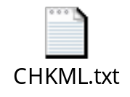
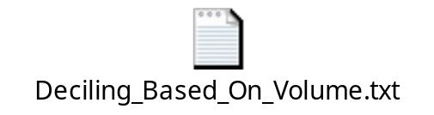
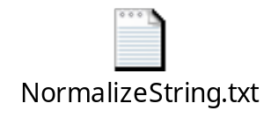


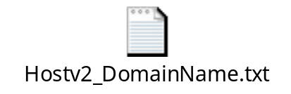
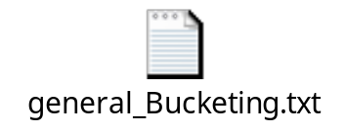
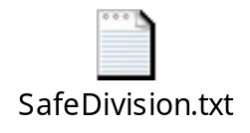
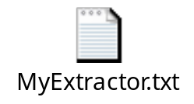
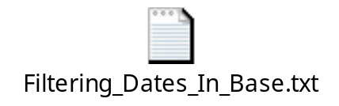
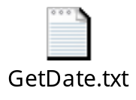
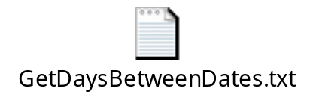
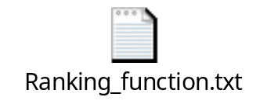
Important C# snippets

Slide 37
Additional Links
Reducer:
  https://microsoft.sharepoint.com/teams/Cosmos/Wiki/REDUCE.aspx
  https://microsoft.sharepoint.com/teams/Cosmos/Wiki/Reducer.aspx
Processor:
  https://microsoft.sharepoint.com/teams/Cosmos/Wiki/PROCESS.aspx
Extractor:
  https://microsoft.sharepoint.com/teams/Cosmos/Wiki/Extractor.aspx
Aggregator:
  https://microsoft.sharepoint.com/teams/Cosmos/Wiki/User-Defined%20Aggregates.aspx
StreamSets:
  https://microsoft.sharepoint.com/teams/Cosmos/Wiki/StreamSets.aspx

